Slide 1
Exploring Areas for Restaurant Recommendation or for new Restaurant Venture in Mexico

Slide 2
Problem Statement: Prospects of a Lunch Restaurant, types of cuisines, parking spaces in Mexico
Mexico is in the global economic power index and definitely one of the best places to start up a new business.
During the daytime, especially in the morning and lunch hours, office areas provide huge opportunities for restaurants. Reasonably priced (one lunch meal 8$) shops are usually always full during the lunch hours (11 am — 2 pm) and, given this scenario, we will go through the benefits and pitfalls of opening a breakfast cum lunch restaurant in highly dense office places.
We will go through each step of this project and address them separately. I first outline the initial data preparation and describe future steps to start the battle of neighborhoods in Mexico.

Slide 3
Data acquisition and cleaning:
The datasets used are Restaurant cuisine, Restaurant Parking, the number of hours and days it is open, etc. There are 9 data files and a README, and are grouped like this:
1 chefmozaccepts.csv
2 chefmozcuisine.csv
3 chefmozhours4.csv
4 chefmozparking.csv
5 geoplaces2.csv
6 usercuisine.csv
7 userpayment.csv
8 userprofile.csv
User-Item-Rating
9 rating_final.csv

Slide 4
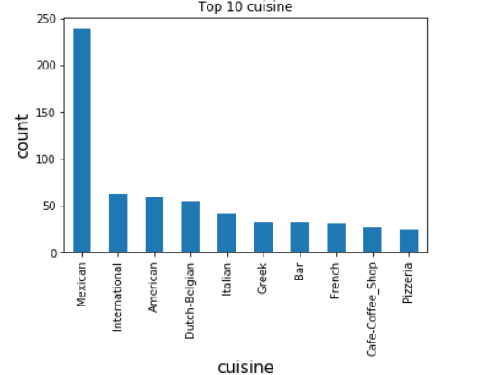
Data Preprocessing: Plot to visualize top cuisines offered by the Restaurants

Slide 5
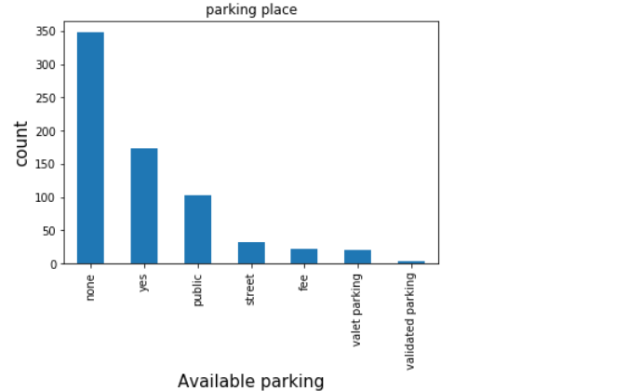
Plot to visualize available parking place at the Restaurants

Slide 6
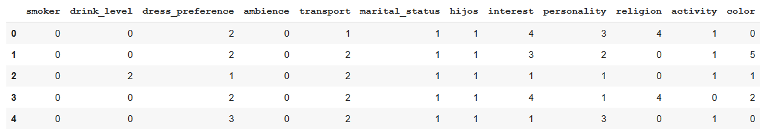
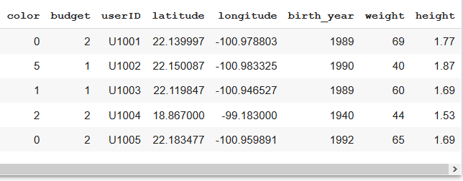
Now performing label encoding to convert char to factors.

Slide 7
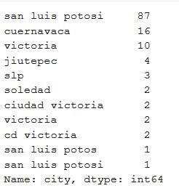
Since some variables contains dirty values, we are going to perform data cleaning on those variables.

Slide 8
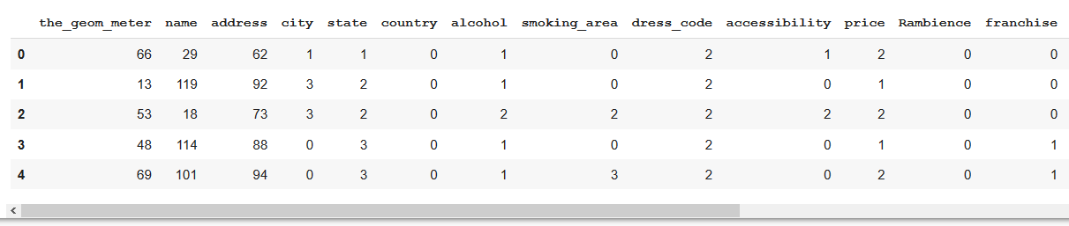
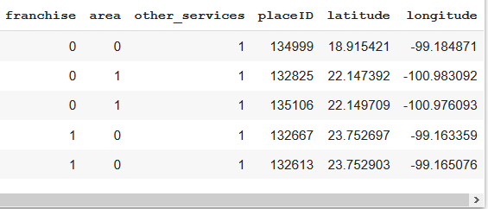
Label encoding

Slide 9
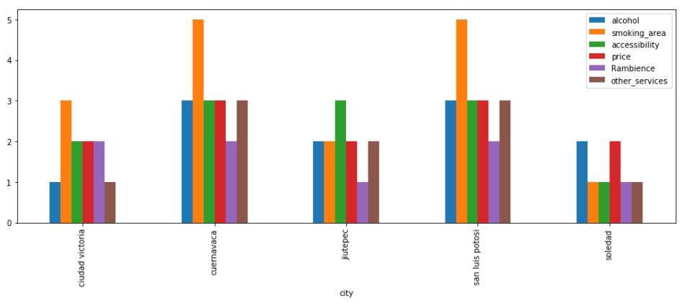
Plot for facilities provided by Restaurants based on city.

Slide 10
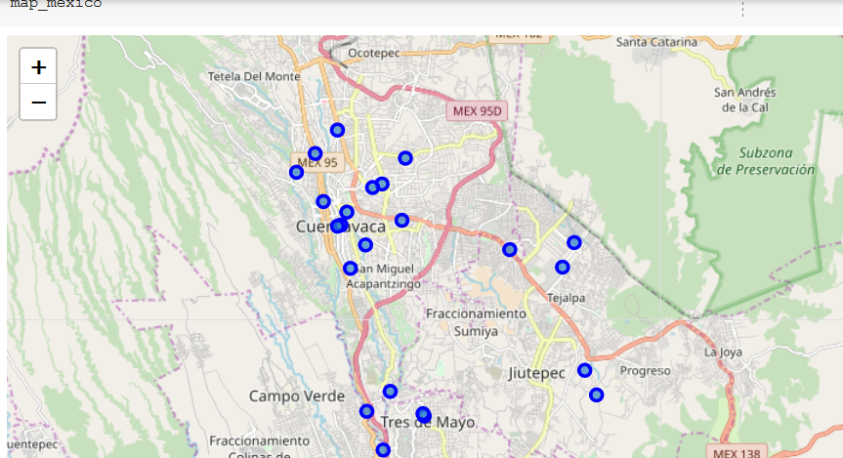
Producing location for the Restaurants on the Map

